Slide 1
A Perfect Storm?
Predicting Wildfires
Deb Fenty, Randy Dettmer, Goutham Polvaram, Hunter Block-Beach

Slide 2
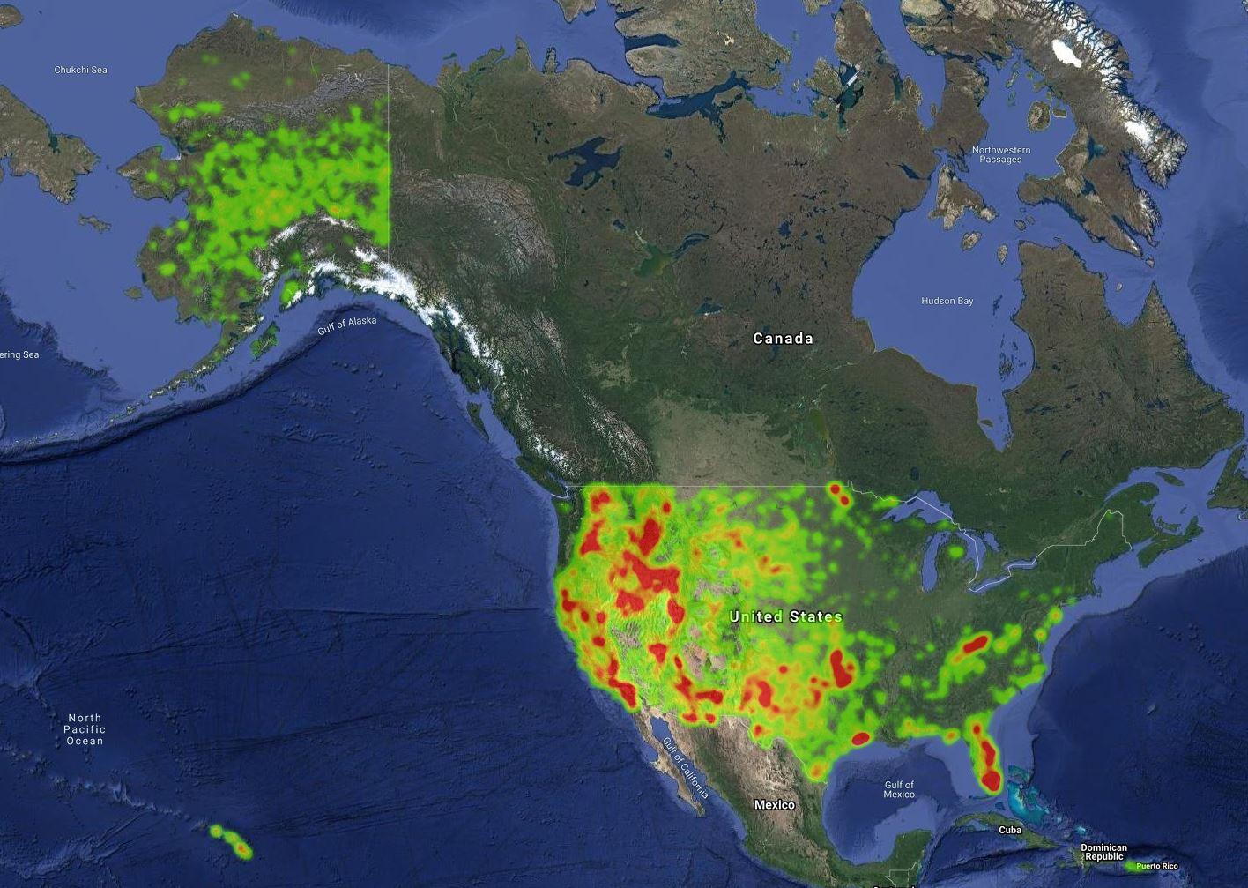
Why we care?
1.9 million wildfires
between 1992 and 2015
2018 California wildfires
1.9 million acres burned
$432M spend on operations
$12B in insurance claims
Notes:
527 fires burning an area of 1,893,913 acres (roughly the size of delaware)
through the end of August 2018, Cal Fire alone spent $432 million on operations
As of May 2019, insurance claims related to this fire season had reached $12 billion, most related to the Camp Fire, in Butte County

Slide 3
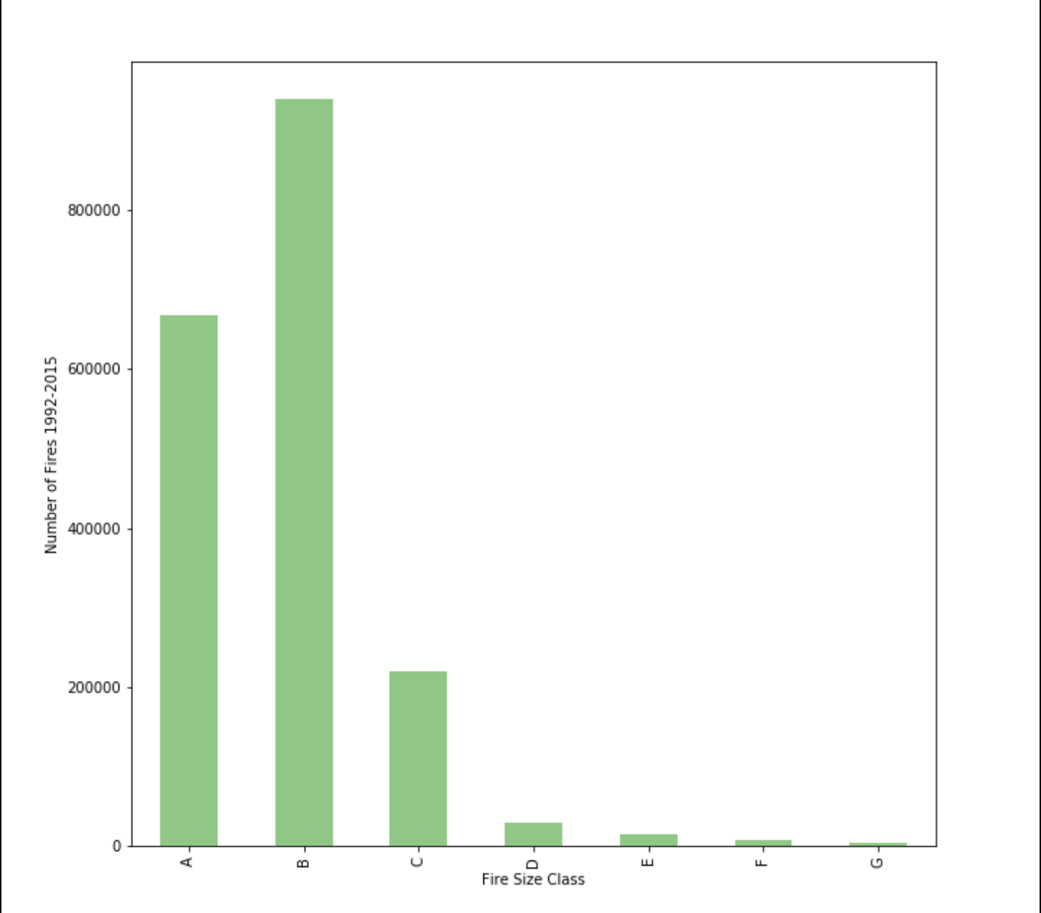
Methodology
Number of Fires Per Fire Class
Data sources:
Dark Sky (API)
Google Geocode (API)
Census Data (2000 & 2010)
Kaggle-Fire Dataset
Data Set:
Limited to F&G fire classes
Chosen due to impact
Statistical tests
Independent T-Test
Pearson Correlations
Kendall Correlations
ANOVA

Slide 4
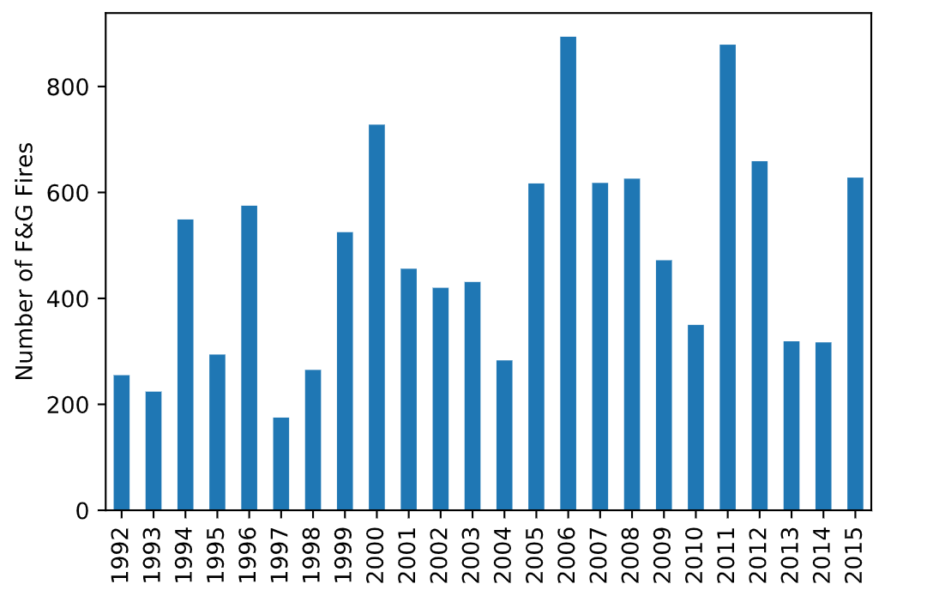
F & G Fires by Year
While fire volumes vary by year, a general increase in fires can be seen over time

Slide 5
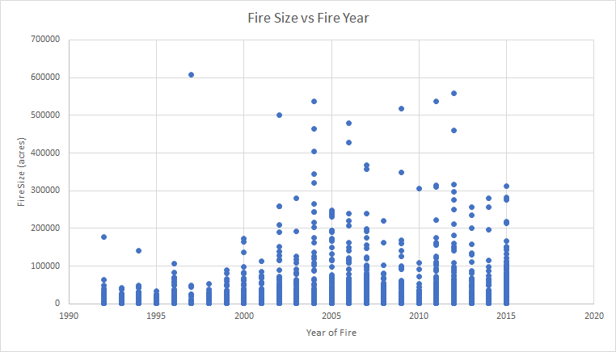
Along with number of fires increasing over time, the size of affected land has been increasing as well

Slide 6
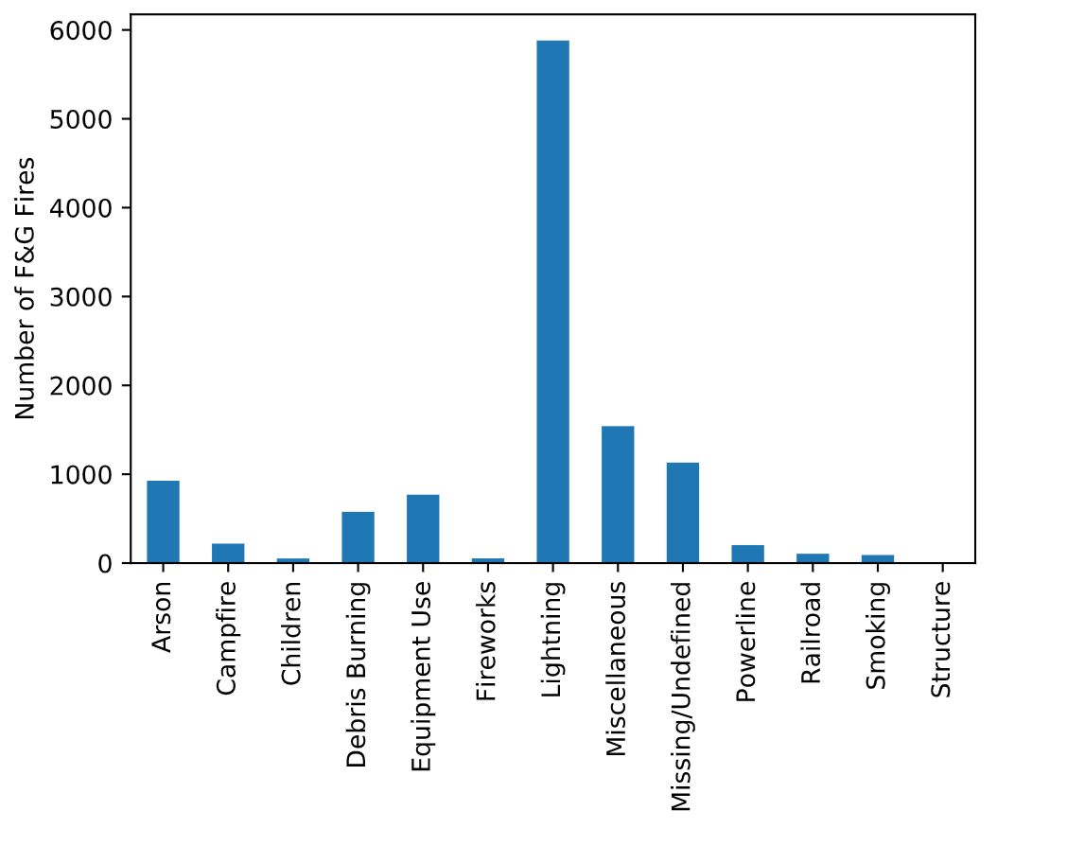
Fire Causes
Lightning is the leading cause of F&G fires.
This may point to natural factors being the biggest factor in forest fires starting

Slide 7
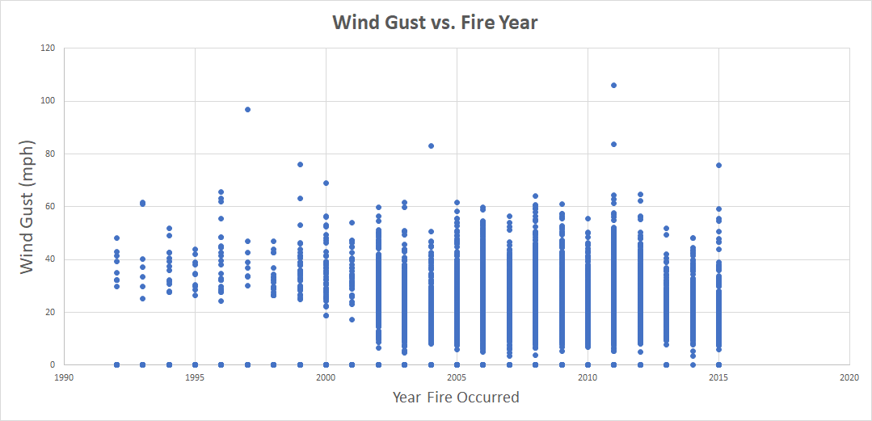
Wind gusts ranges have been increasing, which may point to erratic weather patterns due to climate change

Slide 8
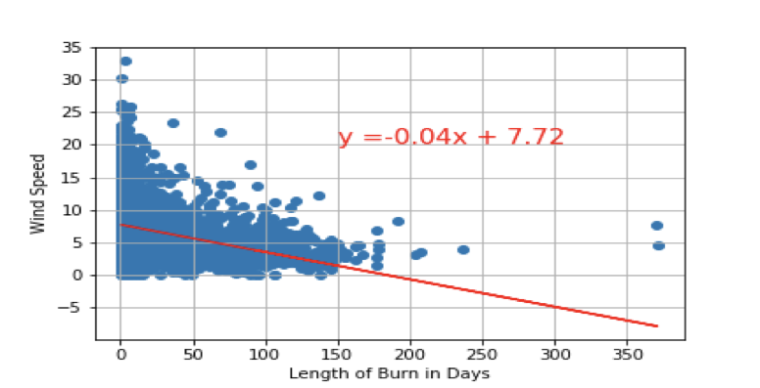
Wind Speed vs Length of Burn r²= -0.3443
Wind speed has a weak, negative correlation to length of burn

Slide 9
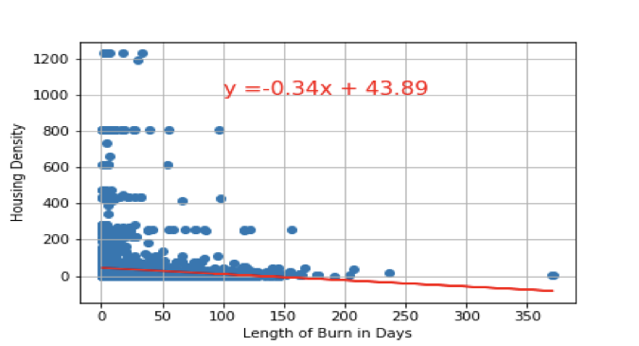
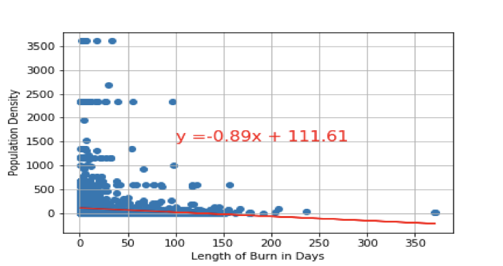
Do Housing or Population Density have an Effect on Length of Burn?
Housing Density r²= -0.1009
Population Density r²= -0.09559

Slide 10
Are there differences between the places that are affected?
Group 1- High temperature on day of fire = >75
Group 2- High temperature on day of fire <75
Population Density: p = .55
Housing Density: p = .16
Water Area: p = 7.3997 x e⁻¹⁴
Humidity: p = 3.7950 x e⁻²⁰⁵
Precipitation Probability: p = 8.6589 x e⁻⁶¹

Slide 11
Limitations and Other Considerations
Limitations:
Limited API calls
Data structure
Future Projects:
Campsite density
Road density
Historical weather patterns
No fires around Great Lakes, look to see if this is pattern around other inland bodies of water

Slide 12
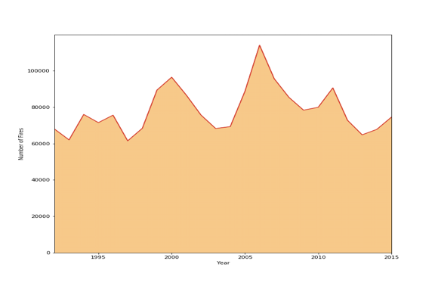
A bit of fun!

